Slide 1
CSE428: image processing
MILESTONE 02 PRESENTATION

Slide 2
Table of contents
Page 03: Introduction
04: Dataset
05: Dataset Distribution
06: Augmentation
07: Alexnet
13: ResNet-50
20: Inception Net
26: Custom Model
33: Results

Slide 3
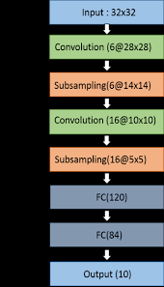
Introduction
AlexNet (2012): Deep Learning milestone. Eight layers, GPU-accelerated, revolutionized image classification.
ResNet-50 (2015): Overcame deep network training hurdles with residual connections, boosting accuracy in image recognition.
InceptionNet (2014): Google's innovation with inception module, excelling in complex pattern recognition for top-tier image classification.

Slide 4
Dataset
We have taken our image dataset and converted it into csv (comma separated values) format so that we can implement our Machine Learning models and interpret the results.
Dataset Size : 2150 images (Train)
250 images (Test)
Image Shape : 64x64x3
There are separate batches of data for Train and Test.

Slide 5
Dataset distribution
get_dataset_partitions_tf efficiently divides TensorFlow datasets into customizable training(80%) and validation(20%) sets.
We can easily adjust distribution percentages with parameters like train_split and val_split
Optional dataset shuffling enhances training diversity, ensuring a well-structured dataset for robust model training.

Slide 6
Data Augmentation
Data augmentation is a technique in machine learning is used to reduce overfitting when training a machine learning model, by training models on several slightly-modified copies of existing data. For this project, we have used the sequential model using TensorFlow which applies all the augmentation layers sequentially.

Slide 7
07
AlexnET

Slide 8
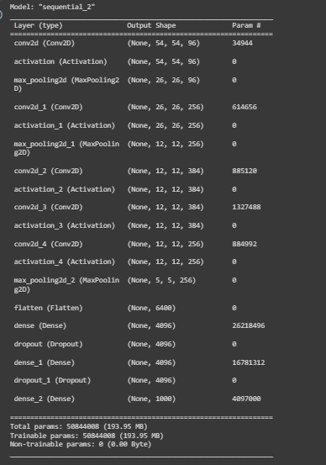
Alexnet
AlexNet, a deep learning milestone, revolutionized image classification with its innovative design. Comprising five convolutional layers and pooling layers, it efficiently extracts hierarchical features and reduces spatial dimensions. Three fully connected layers enable high-level feature learning and classification. Key innovations like ReLU activation, local response normalization, and dropout collectively propelled AlexNet to the forefront of image classification architectures.

Slide 9
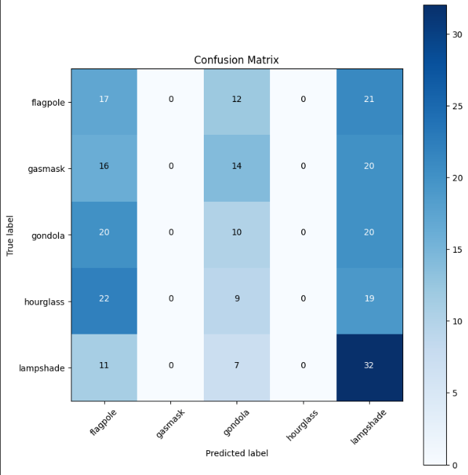
Confusion matrix of Alexnet

Slide 10
Classification Report of AlexNet
Accuracy: Measures the overall correctness of the model's predictions but may not be suitable for imbalanced datasets.
Precision: Indicates the accuracy of positive predictions among all predicted positives. But it is crucial for tasks where false positives are costly.
Recall (Sensitivity): Measures the ability of the model to capture all relevant instances and it is critical for tasks where false negatives are costly.
Specificity: Measures the ability of the model to identify negatives correctly. It is vital for scenarios where correctly identifying negatives is crucial.

Slide 11
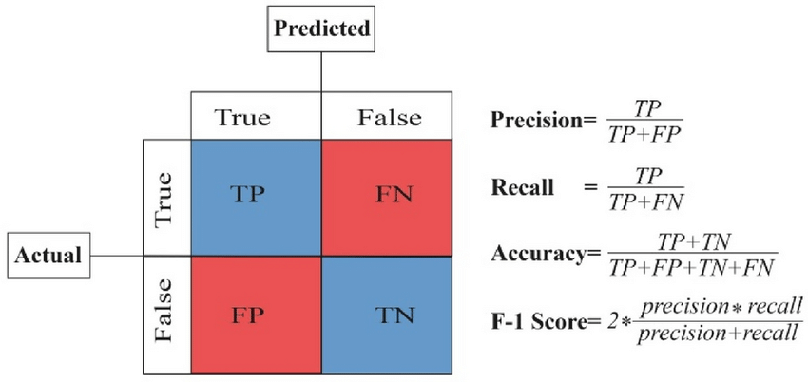
Formulas

Slide 12
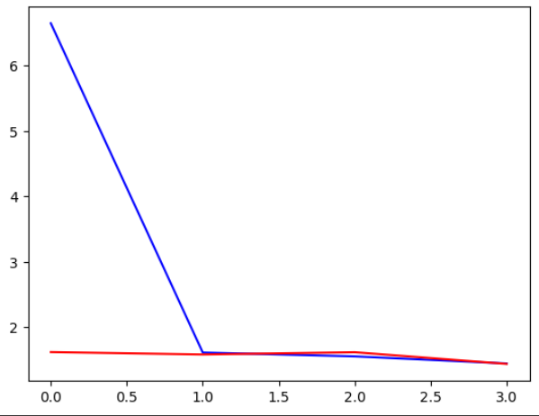
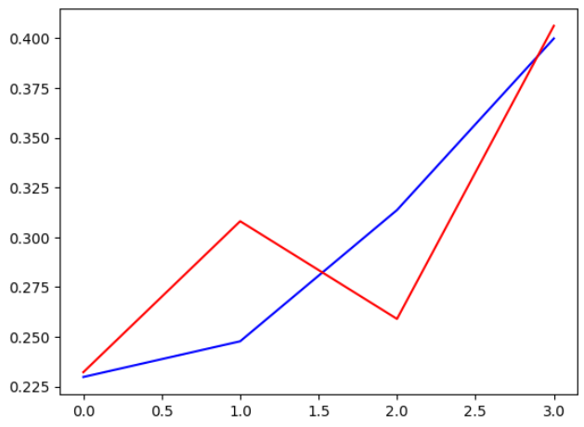
Plots of loss and accuracy
The accuracy and loss plots visually represent the model's training and validation performance over epochs. The accuracy plot demonstrates the model's ability to make correct predictions, while the loss plot illustrates how well the model is minimizing its error. Consistent improvement in accuracy and decreasing loss over epochs is indicative of effective model training and generalization. Red is for Training Set and Blue is for Validation set.
Loss
(1.65%)
Accuracy(20%)

Slide 13
13
Resnet-50

Slide 14
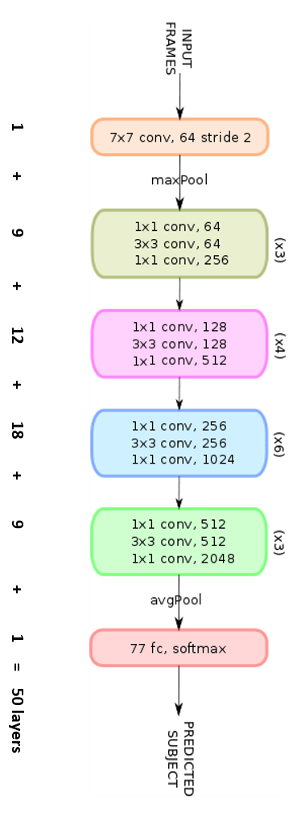
Resnet-50
ResNet-50 is a convolutional neural network that is 50 layers deep. It consists of 5 stages each with a residual block. Each residual block has 3 layers with both 1x1 and 3x3 convolutions. The concept of residual blocks is quite simple. In traditional neural networks, each layer feeds into the next layer. The model skips connection using residual blocks. It is divided into stages. Also uses no pooling and uses only strided downsampling. It can train very deep networks.

Slide 15
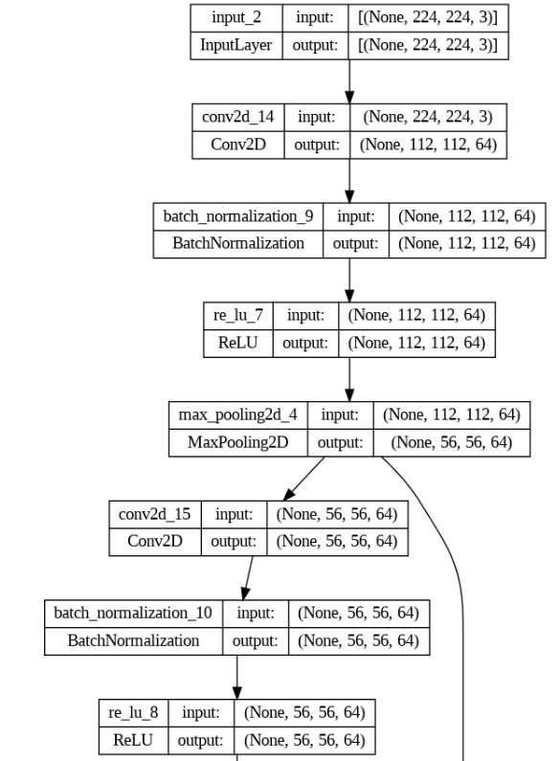
Snippet of our model

Slide 16
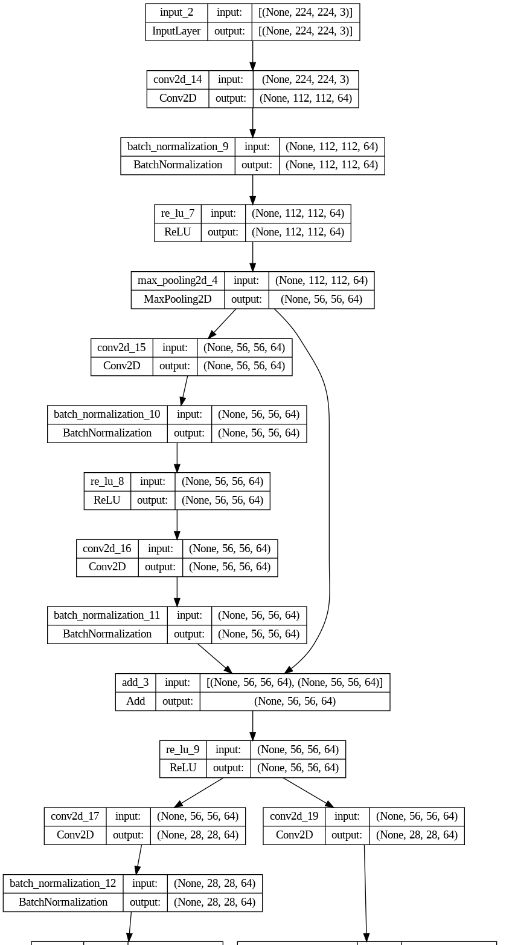
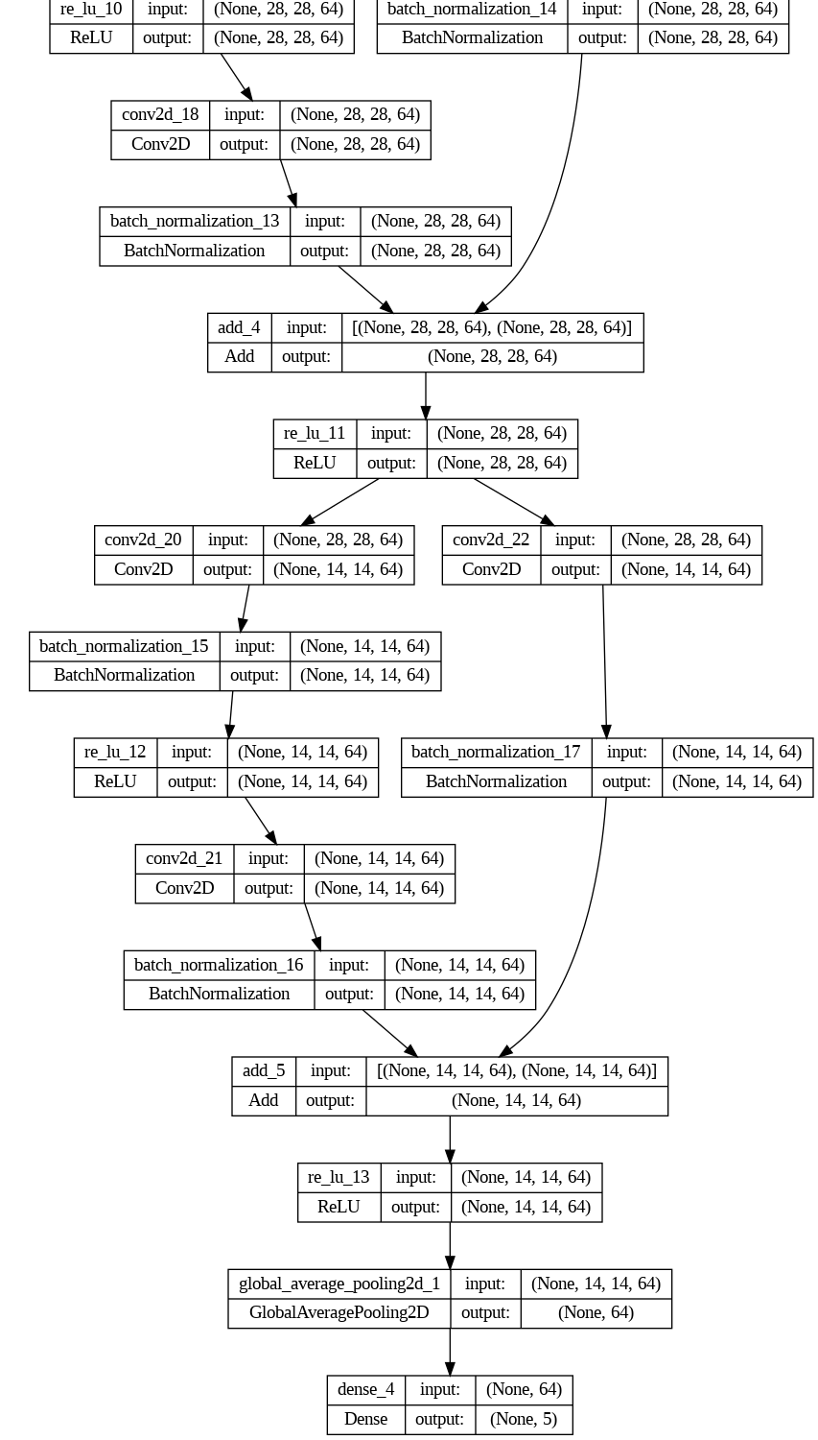
Batch Normalization
We have used batch normalization in layers so they have zero mean and unit variance. Batch Normalization makes the distribution more stable and reduces the internal covariate shift.
70 Epochs were used in our model.

Slide 17
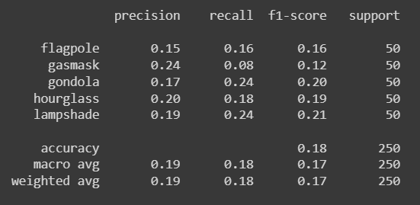
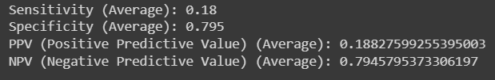
Performance Metrics
sensitivity = tp / (tp + fn)
specificity = tn / (tn + fp)
ppv = tp / (tp + fp)
npv = tn / (tn + fn)

Slide 18
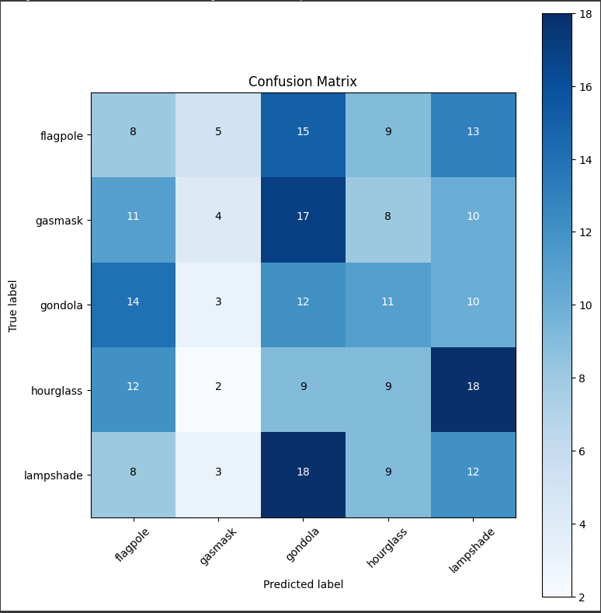
Confusion Matrix of RESNET50

Slide 19
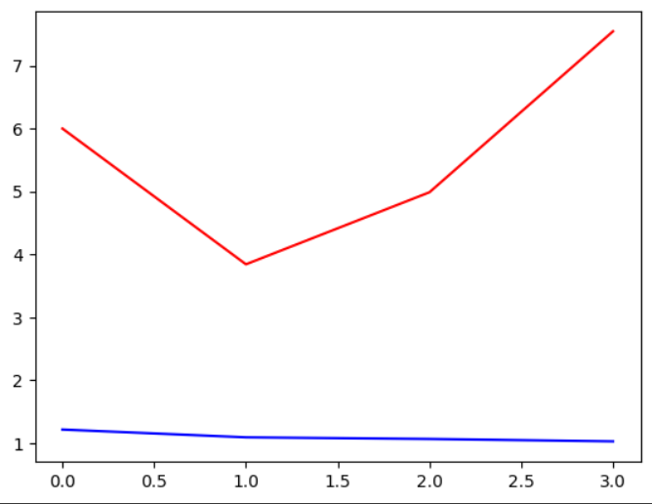
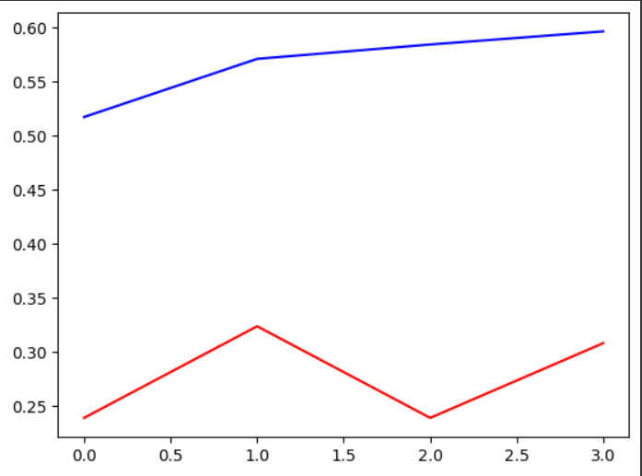
History of Train and Test
Red is for Training Set and Blue is for Validation set.

Slide 20
20
INCEPTION nET
Popularly also known as GoogLeNet

Slide 21
Brief overview of Inception Net
Inception modules
Efficient
computer vision
Inception Net employs modules with parallel convolution layers with varying filter sizes ranging from 1x1 to 5x5 and a max pooling layer allowing us to capture all features at various spatial scales.
Use of modules and 1x1 convolutions reduce the number of parameters and increase efficiency by reducing the computational complexity allowing us to use deeper networks.
It is widely used in the field of computer vision and deep learning related tasks due to its efficiency in processing visual data and capturing diverse features.

Slide 22
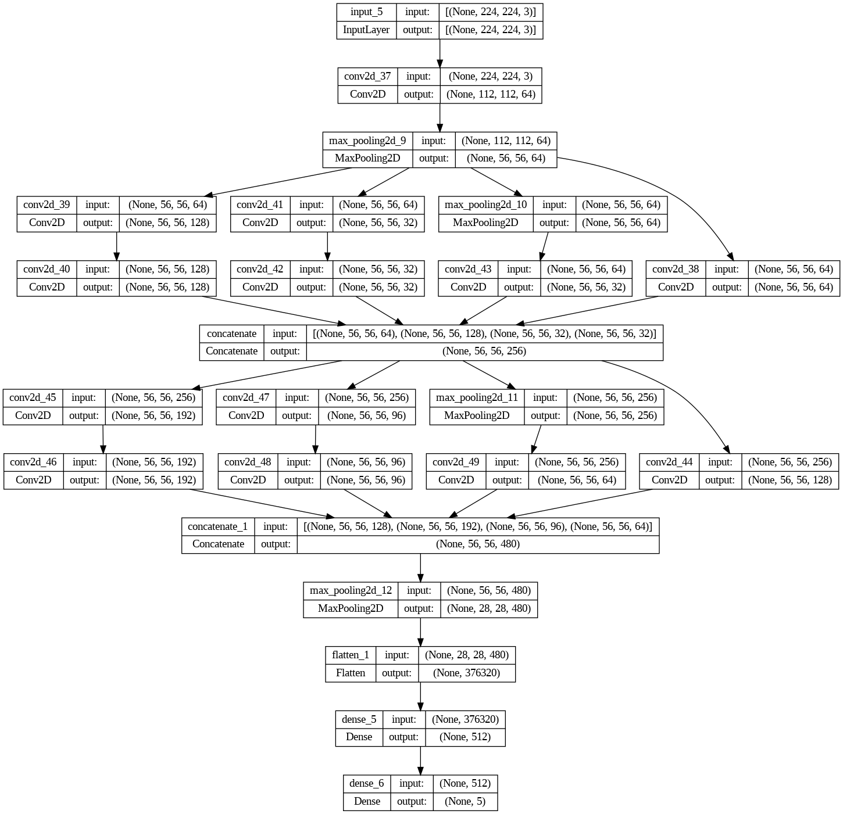
INCEPTION mODEL
One on the right is a visual representation of our inception model.
You can see the multiple inception models with different filter sizes and accompanying max pooling layer.
We have used Relu activation functions for the layers with a final Softmax function for the output layer.

Slide 23
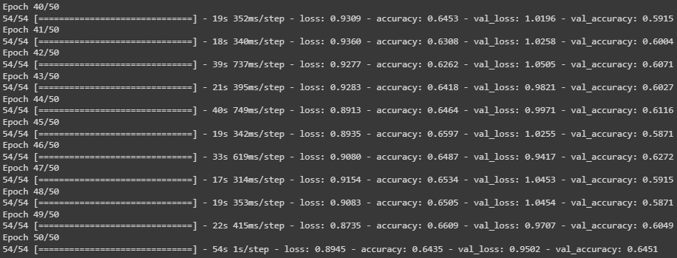
Performance of inception net
We have ran 50 epochs of inception net and got a final training accuracy of 0.6435 and
validation accuracy of 0.6451. Our final testing accuracy for inception net was 0.5240.

Slide 24
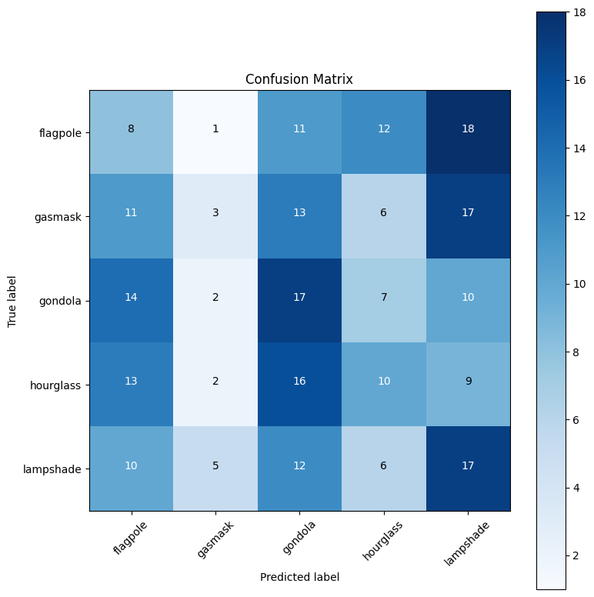
Confusion Matrix of
Inception net
Predictions results of our model.

Slide 25
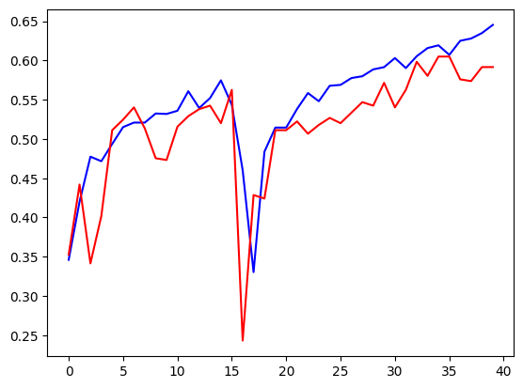
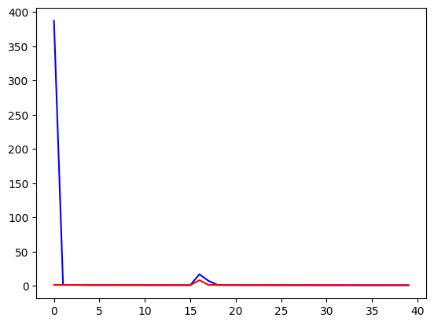
History of Train and test
Training set represents the red curve and validation set represents the blue curve.

Slide 26
26
Custom model

Slide 27
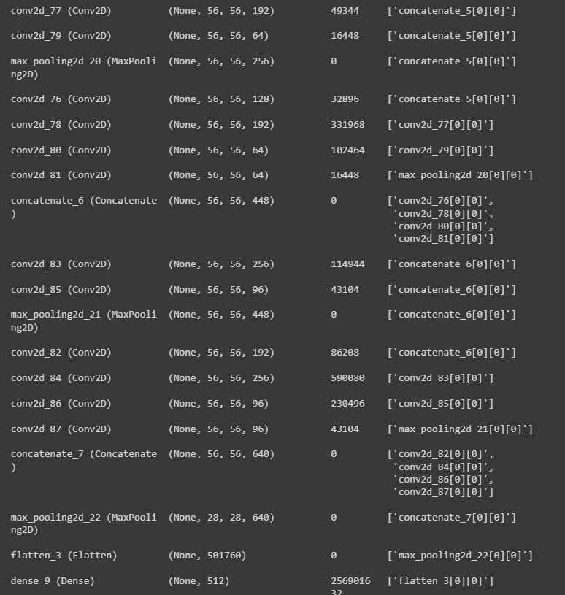
Custom Model
We have attempted to build a custom inception model where we have implemented everything shown in this output snippet.
Total params: 258761029 (987.09 MB)
Trainable params: 258761029 (987.09 MB)
Non-trainable params: 0 (0.00 Byte)
40 Epochs were used.

Slide 28
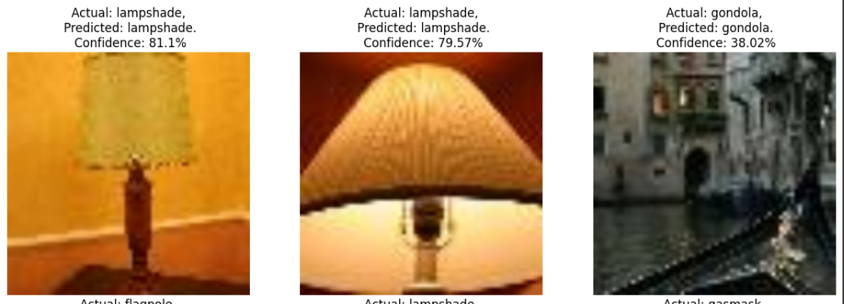
Predicted images and misclassification
In the subsequent slides, you will see multiple images that have been classified. Some of the predicted labels have been generated correctly with high confidence scores while some few others have been labelled incorrectly which signifies the model cannot classify all images properly.

Slide 29
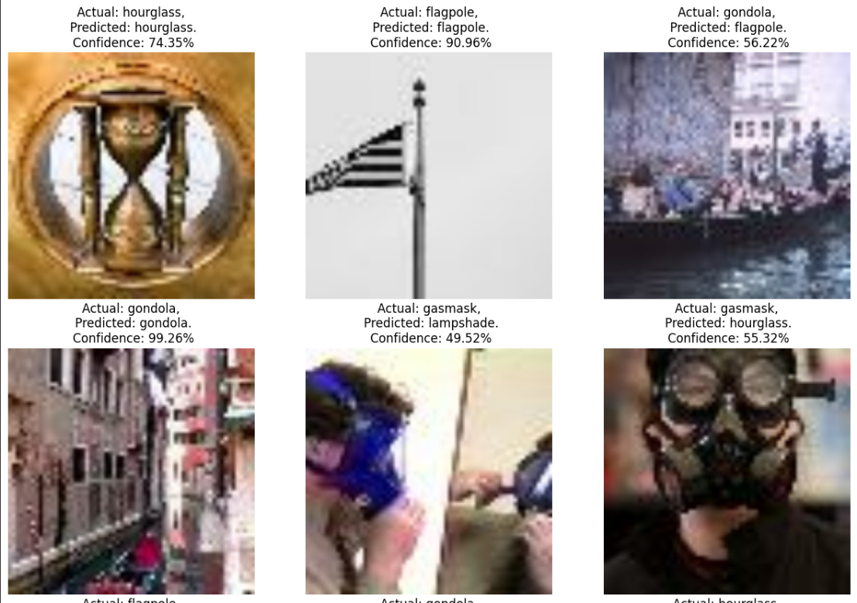

Slide 30
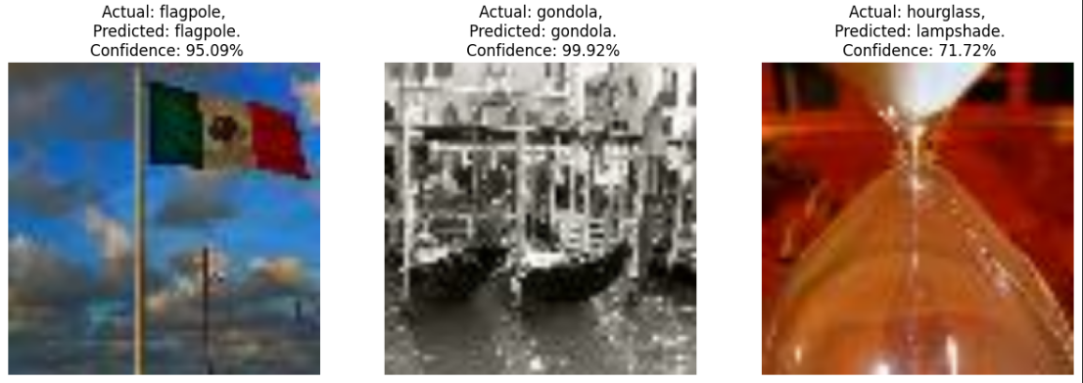
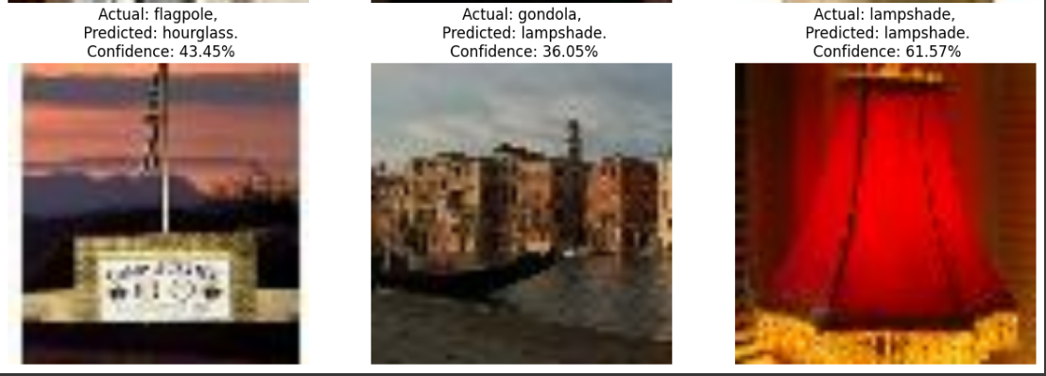

Slide 31
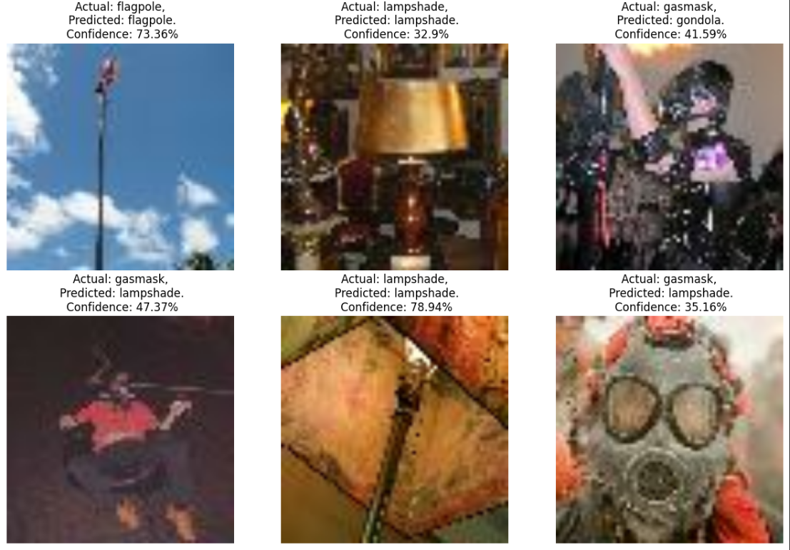

Slide 32
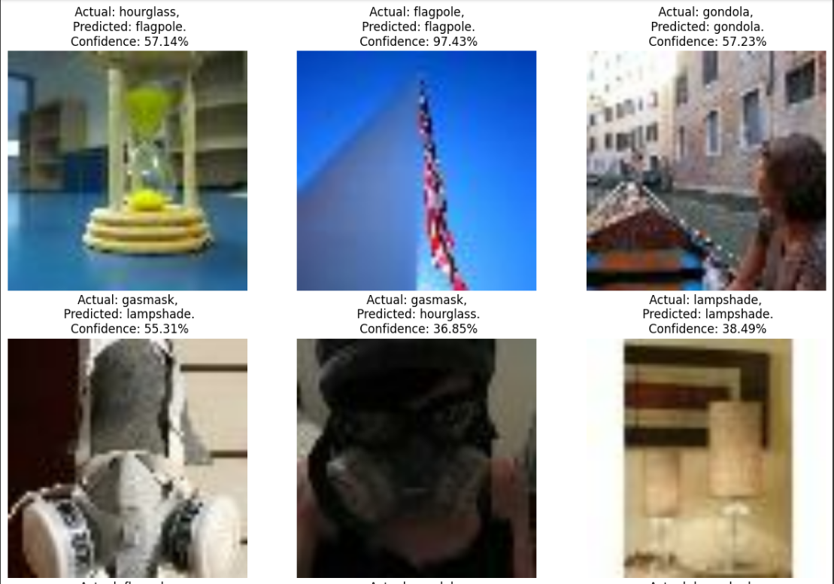

Slide 33
33
Results

Slide 34
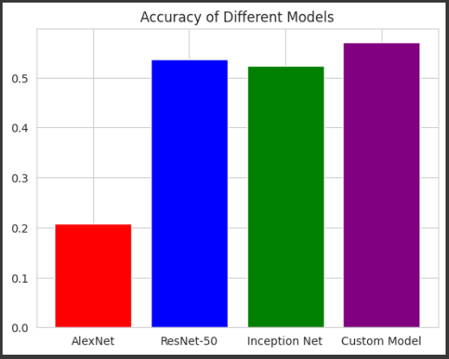
Comparison of results
Here, in this bar chart, we can see a side by side comparison of accuracy of all 4 models. AlexNet seems to have the lowest accuracy. There is a huge jump in accuracy for ResNet-50. Almost similar but slightly lower for Inception Net. We observed maximum accuracy for the Custom Inception Model.

Slide 35
THANK YOU!
Hope you liked our presentation. Please ask if you have any questions.

